Slide 1
Version 1
Created by
Vadan Mehta

Slide 2
Copyright
Copyright (c) 2009-2012 The Open Group. All rights reserved.
This material ("Material") may not be used, copied, distributed, modified, or shown, except under license from The Open Group.
Open Group member organizations are hereby granted a non-exclusive license to use, copy, distribute and show the unmodified material for any purpose, for so long as they are current, paid-up members of The Open Group. Others may use, copy, distribute and show the unmodified material free of charge for non-commercial use. That will usually mean using it inside the organization, and not for commercial exploitation. To use the material for commercial purposes, an organization must apply to The Open Group for a Commercial License.
Any modification to the original Material, or any document that contains any portion of the Material shall constitute a derivative work. Anyone may create such derivative works and shall retain all right, title and interest in the changes or additions it makes to the Material, but nothing herein shall be deemed to transfer any right, title or interest in the Material. Furthermore, any derivative work shall always fully acknowledge the right, title and interest of The Open Group in the original Material (together with any contributor acknowledgements), and shall not claim or imply that any derivative work is the official Material. For the avoidance of doubt, creating a derivative work for commercial use shall constitute commercial use of the Material.

Slide 3
Objective
This presentation’s objective is to present The Open group’s Legacy to SOA Evolution Guide in tutorial format.
Intended audience for this tutorial are, SOA project managers, solution architects, migration planners, marketing executives, presales personnel and SOA beginners.
Disclaimer:
Content of this tutorial is based on Author’s interpretation of L2SOA guide. Author takes complete responsibility of information, presented herein.
Legacy Evolution to SOA tutorial

Slide 4
What Will you learn
Introduction to L2SOA guide
Overview
Drivers for Legacy Modernization
Approach to Enable L2SOA
Key SOA Principles
Metrics for L2SOA Engagement
Modernization Strategies
EIP Pattern-Based SI Approach
Organization and Process
SOA Governance Reference Model
SOA & Security

Slide 5
Introduction to L2SOA guide
.
Legacy Evolution to SOA (L2SOA), is a Open Group guide and has been developed by the L2SOA project of the SOA Work Group.
The main goal of Legacy to SOA guide is to leverage the collective experiences of L2SOA practitioners to develop legacy evolution best practices and lessons learned to improve the success of L2SOA implementations.
It contributes to The Open Group vision of boundary less Information flow by leveraging and fostering common understanding of L2SOA among all the stakeholders( Service Providers, Vendors, System Integrators, Developers)
It’s content is based on real projects

Slide 6
Overview
Legacy Application or System
An information system that may be based on outdated technologies, but is critical to day-to-day operations. (Gartner Definition)
Knowledge backbone of organizations.
Created in an era where integration, flexibility, and company mergers were not as prominent as they are today.
Difficult to replace
SOA
An architectural style that supports service-orientation
Enables a staged transition from a (partly) silo based system landscape towards an integrated, componentized, and shared service environment
Enables Legacy modernization
Legacy to SOA (L2SOA)
An approach to enable legacy systems to be integrated into a silo-transcending landscape and processes using SOA

Slide 7
Drivers for Legacy Modernization
Drivers/concerns for legacy application modernization as SOA initiative, are as follows:
Business
Function
Usability
Technology

Slide 8
Drivers for Legacy Modernization
Business
Maintenance Cost higher for legacy applications
Slow Time to market due to higher upgrade time
Unknown dependencies among system, increasing risk of higher downtime
No sufficient business process metrics
Function
Restricted the interoperability because of Application’s silo architecture
Non Sharable Data
Limited Re-usability
Similar functionality in different applications
High Risk of Data inconsistency
Limited Process Automation opportunities

Slide 9
Drivers for Legacy Modernization
Usability
No Single-Sign-On (SSO) support.
Poor usability due to basic screens.
Inability to integrate with new user technologies
Technology
Applications are tightly-coupled
Embedded logic makes re-usability difficult
No vendor support for “out of date” technology
Application Source code may not support modern communication standards and protocols
Complicated System configuration

Slide 10
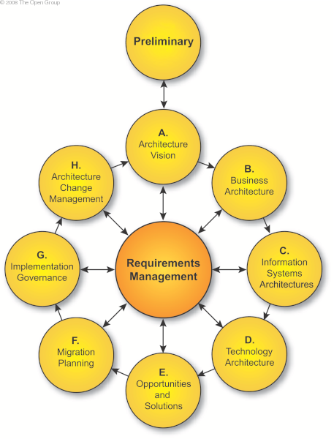
Approach to Enable L2SOA
The TOGAF (ADM) combined with TOGAF SOA Guide provides stepwise approach for L2SOA transformation engagements.
SOA Maturity Assessment
Change Impact on overall Architecture
Defining Change Mgt process
High level description of Arch Vision
Organizational approval of Target architecture
ROI assessment
Current Architecture(As-IS) assessment
Gap Analysis
Target Architecture (To-be)
Business Architecture
Application Landscape
Technology Arch
Execute
Transition & Implementation Plans
Best Transition Architecture
Identifying Solution Building Blocks(SBB)

Slide 11
Approach to Enable L2SOA
The Preliminary Phase
SOA maturity assessment report(“fit-for-SOA” state of the current legacy architecture)
The architecture governance and support strategy Confirmation
SOA RA for Architecture Repository and Architecture Building Blocks (ABBs) at initial stage
Involvement of Legacy representatives in transformation program
Phase A: The Architecture Vision
RoI based business case for L2SOA evolution
Upgrade or Replace legacy system ?
ADM (Phases B, C, and D)
Current State Architecture Assessment (As-IS)
Identify the legacy systems, their functionality and integration with other apps
Identify Legacy systems and business process relationship
SOA enablement assessment
Target State Architecture(To-be)
IT system alignment with Business and IT services
Legacy Portfolio Rationalization

Slide 12
Approach to Enable L2SOA
Phase E: Opportunities and Solutions
Transition Architectures with options for migration path and enterprise wide impact analysis
Identifying Solution Building Blocks (SBB), based on gap analysis
Final decisions are made about which specific legacy systems will be transformed towards SOA style and in which priority.
Vendor selection to provide tools for legacy integration, SOA infrastructure components, and to replace legacy systems
Phase F: Migration Planning
Phased approach to modernize the legacy systems
SOA maturity analysis at each stage
Phase G: Implementation Governance
Legacy system specialists involvement in architecture decisions
Impact analysis on existing operations and departments
Phase H: Architecture Change Management
Change impact analysis on business environment ,system architecture and applications due to Legacy evolution program

Slide 13
Key SOA Principles
Well-Defined Service Contract
Service interactions must be well-defined with a widely supported standard.
Define Services with Appropriate Granularity
Services granularity should make it easy for service requestors to assemble services to execute business scenarios.
Loosely-Coupled Services
SLA based Service implementation .
Legacy systems can be migrated or replaced by other technology, without affecting the service and therefore the service requestor.
Design Services for Stateless
Services invocation must be independent of the state of other services (minimal functional intertwining)
Ensure Services have Appropriate Security Enforcement Standards
Mapping between individual system security information to centralized security mechanism.
Adopt SOA Ontology/Vocabulary Standard

Slide 14
Metrics for L2SOA Engagement
Metrics provides a baseline measurement to justify an L2SOA engagement.
Metrics should be measured at appropriate intervals and reported for continues improvement and measure the overall performance.
Key Metrics for an L2SOA engagement:
Application Usage
Cost Reduction
Functional Re-use
Quality of Service
Revenue-generated
Time-to-Market
Security KPIs (data protection-related KPIs)

Slide 15
Modernization Strategies
Modernization strategies to enable the process of modernizing legacy applications using SOA.
Enterprises need to select one or more strategies, after in-depth evaluation.
Key Modernization Strategies
Service Enablement
Language Conversion
Re-Architect
Re-hosting of Applications

Slide 16
Modernization Strategies: Service Enablement
Approach
The access of legacy applications through services hosted by integration platforms and/or service containers.
Problem Solved/Value-Add
Re-use and leverage existing assets while protecting huge investments made in legacy Applications
Improve value of core applications by using SOA
Leverage legacy functionality in automated business processes spanning multiple systems and departments
Risks and Mitigations
Difficult to identify useful legacy functionality to be leveraged; mitigated by detailed business process analysis and mapping, and conducting (both static and run-time) code analysis
Poor documentation can lead to unknown functionality versus clear service interface.
System transformations may be disruptive. Proper analysis is necessary to understand organizational, process and technology impact

Slide 17
Modernization Strategies: Language Conversion
Approach
To converting applications written on legacy languages into languages, that supports SOA enablement by default
Problem Solved/Value-Add
Reduce Total Cost of Ownership (TCO) of the applications – mainframe, hardware, software license fees, and learning costs.
Reduce time-to-market with equal or better performance, availability, and scalability.
Applications can be made adaptable to SOA implementation.
Risks and Mitigations
Impossible to provide structured autonomous services; mitigation is to use another strategy(Re-architect)
No supported functions in the latest version of the languages; mitigation could be to analyze transformation and convert to compatible modules providing equivalent functionality.
Skill/training used for analyzing old platform/technology/languages might be scarce; mitigation could be to ensure access to key resources with legacy skills.

Slide 18
Modernization Strategies: Re-Architect using New Environment
It re-architects the business logic towards a modularized design. This design enables the creating of autonomous services that can access the functional modules. Two sub-strategies are identified:
Re-Architect, but Use the New Environment
Re-Architect, but Use the Same Environment
Re-Architect, but Use the New Environment((e.g., Language, Platform)
Approach
This is a combination of restructuring in specific functional
modules, combined with a language conversion.
Problem Solved/Value-Add
Possible to fix old problems and introduce new functionalities.
Risks and Mitigations
Budget discussion; need good arguments why one of the other approaches was not chosen.

Slide 19
Modernization Strategies: Re-Architect using Same Environment
Re-Architect, but Use the Same Environment
Approach
The mainframe source is first restructured into specific functional modules. Then these modules are opened up with adapters and integrated with a service mediation component.
Problem Solved/Value-Add
Re-use and leverage existing business functionality and intellectual property.
Risks and Mitigations
Poor and old documentation especially on the system structure is a huge risk. Part of re-architecting will be spent on documenting the system as-is.
Re-architecting might lead to programming changes (e.g., split functionalities and code).
Needs additional testing, especially regression testing

Slide 20
Modernization Strategies: Re-Hosting of Applications
Approach
Re-hosting legacy applications by shifting applications from a legacy environment such as a mainframe to Windows or UNIX, to reduce the cost of mainframe platform. This strategy on its own does not transform the legacy system to SOA. It needs to be combined with one or more of the strategies described earlier.
Problem Solved/Value-Add
Preserve business logic and protect existing investments in legacy applications.
Improve their competitiveness by integrating legacy applications with new applications.
Maintain the end user's experience on the front end of the application and yield cost savings.
Reduce time-to-market with equal or better performance, availability, and scalability
Risks and Mitigations
Preserve business logic and protect existing investments in legacy applications.
Improve their competitiveness by integrating legacy applications with new applications.
Legacy Evolution to SOA tutorial

Slide 21
EIP Pattern-Based Approach
Enterprise Integration Patterns(EIP) are the Design Patterns that facilitate the system integration framework for Legacy to SOA evolution. As large enterprises having complex enterprise systems with various types of legacy applications often leverage a combination of EIP approaches to provide the capabilities to modernize their architecture.
The following patterns are mostly used (one or a combination):
Enterprise Integration (Service Bus)
Queue-based Mediation
Service Enablement
Screen Scraping
Re-design

Slide 22
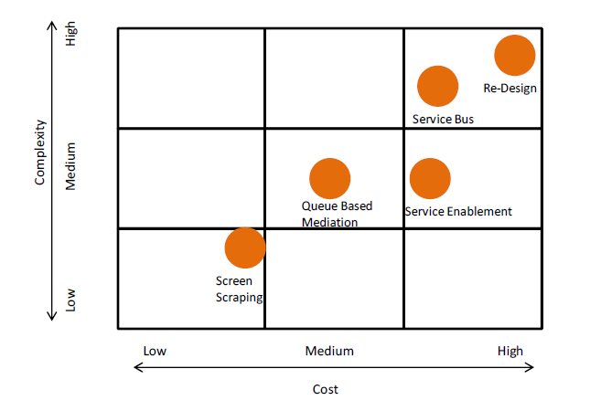
EIP Patterns: Cost & Complexity Analysis
The directly SOA related patterns have a high cost and medium-to-high complexity.
High costs of SOA related patterns, can be spread across many service-enabled applications – both legacy and new, than web-service based pattern as Screen-scraping.
SOA enablement of legacy systems needs to be seen in the context of the enterprise as a whole and not as individual systems

Slide 23
Organization and Process
Legacy evolution has impact on current organization and process, as follows:
L2SOA is a transformation program and has to be approached and managed as such.
Impact analysis on current IT operations and management teams and Legacy processes
Employee training plan on skill development regarding new technology and new roles, they have to adapt.
Risk analysis of Employee’s inability to adapt new environment
Current change request procedures need to be extended.
In a new service oriented context. Service Owners have to work across business boundaries and above departmental silos both from a functional and technical perspective.
ROI analysis for L2SOA transformation project, based on Matrics and KPIs.

Slide 24
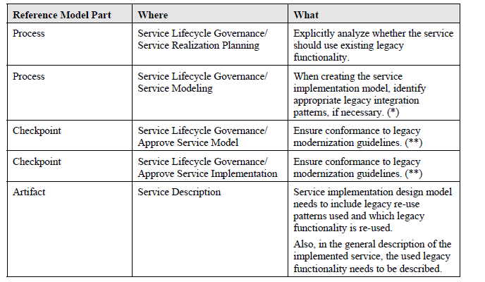
SOA Governance Reference Model
The Open Group SOA Governance Framework’s goal is to enable organizations to define and deploy their own focused and customized SOA governance model.
The table below shows an overview of the defined touch points of the SOA Governance Framework with legacy systems.

Slide 25
SOA & Security
SOA as a loosely-coupled architecture, requires a solid and robust security model.
Each Organization has own security architecture model, thus there is no one-size-fits-all model
Identity management solution including Single Sign On (SSO), is not aligned with the non-centralized solutions.
Approach
The Open Group Security for the Cloud and SOA project, describes two sets of
principles largely:
A set of 20 generic security principles common to all designs aiming to assure a secure IT architecture, ranging from “security by design” to “data protection lifecycle”.
A specific set of principles regarding assuring security in architecting the cloud and the SOA environment, mainly focused on policies, data protection and privacy, and cloud specific principles.
Those principles are also relevant for L2SOA engagement

Slide 26
Legacy and Security
Legacy System security Concerns for L2SOA transformation:
Outdated technology and software
Vulnerable to newer technologies
Closed Encryption
An ingenious manual administration of user names and passwords
Session definition in the legacy system, especially in connect of SSO

Slide 27
Case Study : Large Telecommunications Company (Address Management)
Disclaimer :
Part of case study, has been presented herein. To read complete case study, please visit ( https://www2.opengroup.org/ogsys/publications/viewDocument.html?publicationid=12590&documentid=11481 )

Slide 28
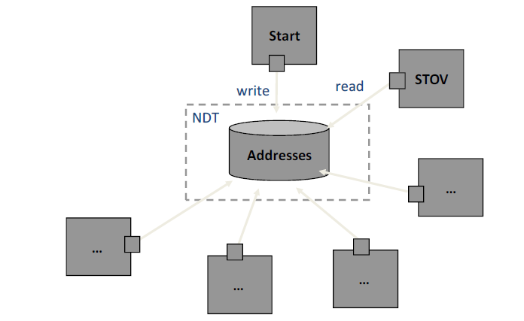
Case Study : Large Telecommunications Company (Address Management)
Baseline Architecture(AS-IS)
A legacy database, consisting of nine distributed, redundant databases.
Changes are replicated through a central hub database.
The client applications access the database through proprietary APIs.

Slide 29
Case Study : Large Telecommunications Company (Address Management)
The high-level migration plan for Address Management Database
(Roadmap to SOA) :
Step 1:
Migrating data from the legacy database to the targeted new database system by:
Implementing New Information Model( using TMForum’s SID data model)
Data Validation and Data Cleansing
Step 2:
The new database becomes the master of address data
Step 3:
All other applications are migrated one by one to access the new data source.
Step 4:
After all applications are switched to new data source, the legacy database will be retired.

Slide 30
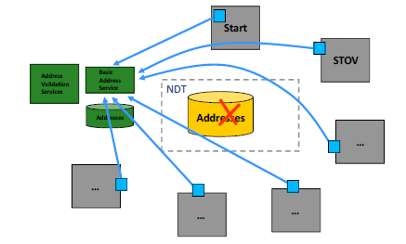
Case Study : Large Telecommunications Company (Address Management)
To-Be Architecture
AS-IS
To-BE
For more details, Please read
The Open Group guide : Legacy Evolution to SoA

Slide 31
Summary
The main goal of Legacy to SOA guide is to leverage the collective experiences of L2SOA practitioners to develop legacy evolution best practices and lessons learned to improve the success of L2SOA implementations.
Business, Functional Usability and Technology are key drivers for Legacy to SOA initiated modernization.
The TOGAF (ADM) combined with TOGAF SOA Guide provides stepwise approach for L2SOA transformation engagements.
SOA initiative has to be measured for ROI and other performance concerns, using industry standard metrics.
Key SOA Modernization Strategies for Legacy transformation are Service Enablement, Language Conversion, Re-Architect and Re-hosting of Applications. Organization can adapt single or more modernization strategies based on the system requirement.

Slide 32
Summary
Enterprise Integration Patterns(EIP) are the Design Patterns that facilitate the system integration framework for Legacy to SOA evolution. Each EIP pattern has different cost and complexity measures.
SOA initiative have impact on existing organizational policies, process and resource planning. The Open Group SOA Governance Framework’s goal is to enable organizations to define and deploy their own focused and customized SOA governance model.
SOA as a loosely-coupled architecture, requires a solid and robust security model.
For more details, Please read: The Open Group Guide : Legacy Evolution to SOA ( https://www2.opengroup.org/ogsys/publications/viewDocument.html?publicationid=12590&documentid=11481 )

Slide 33
Questions please
?

