Slide 1
EC ISA Core Vocabularies v1.0 Mapped to UDEF

Slide 2
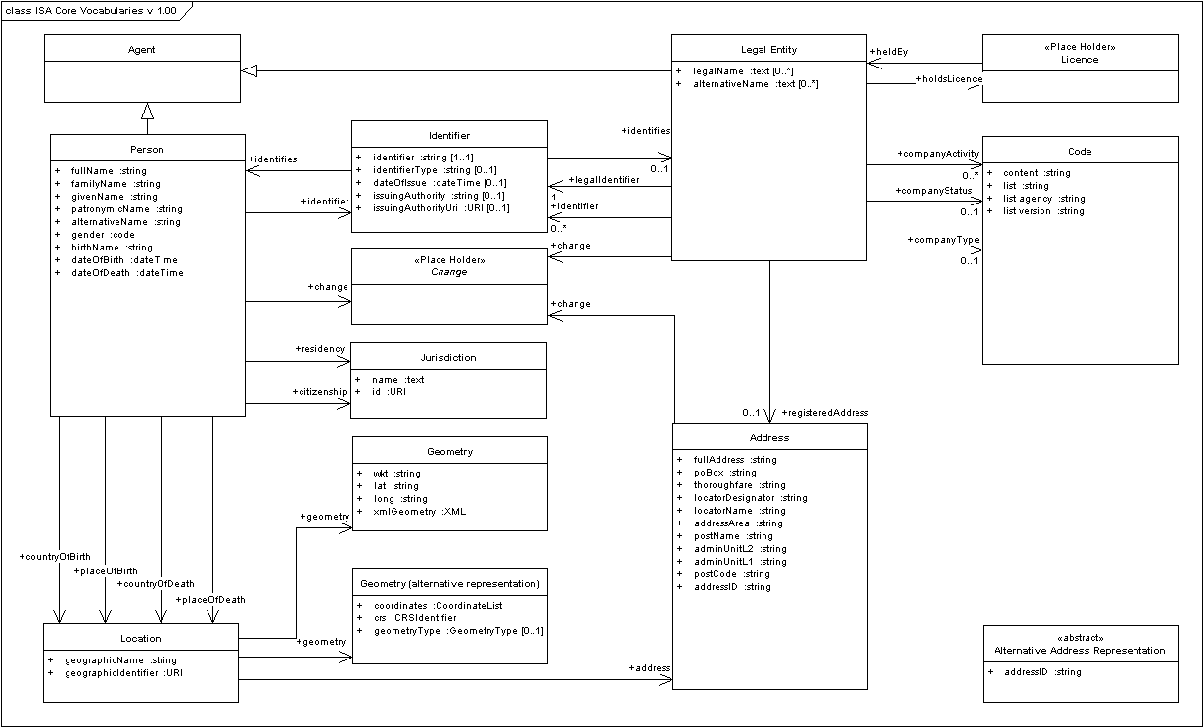
EC ISA Core: Person - Business - Location

Slide 3
EC ISA Core Person Mapped to UDEF
ISA Core Person Concept | UDEF Object | UDEF Property | UDEF ID
fullName | Person | Full Name | 5_2.10
givenName | Person | Given Name | 5_12.10
familyName | Person | Family Name | 5_11.10
patronymicName | Person | Patronymic Name | 5_62.10
alternativeName | Person | Alias Name | 5_40.10
gender | Person | Gender Code | 5_3.4
birthName | Person | Birth Name | 5_63.10
dateOfBirth | Person | Birth Date-Time | 5_3.5
dateOfDeath | Person | Death Date-Time | 5_16.5
countryOfBirth | Person | Birth Country Code | 5_10.36.4
countryOfDeath | Person | Death Country Code | 5_11.36.4
placeOfBirth | Person | Birth City Name | 5_2.10.10
placeOfDeath | Person | Death City Name | 5_4.10.10
citizenship | Person | Citizenship-Country Name | 5_42.10
residency | Person | Residence Country Code | 5_12.36.4

Slide 4
EC ISA Core Business Mapped to UDEF
ISA Core Business Concept | UDEF Object | UDEF Property | UDEF ID
legalName | Enterprise | Registered Name | 3_18.10
alternativeName | Enterprise | Additional Name | 3_39.10
companyType | Enterprise | Type Code | 3_33.4
companyStatus | Enterprise | Status Code | 3_9.4
companyActivity | Enterprise | Industry Classification Code | 3_3.4.4
legalIdentifier | Enterprise | Registration-Authority Assigned Identifier | 3_14.35.8
registeredAddress | Enterprise | Address Text | 3_12.14

Slide 5
EC ISA Core Location Mapped to UDEF
ISA Core Location Concept | UDEF Object | UDEF Property | UDEF ID
geographicName | Place | Name | 7_10
geographicIdentifier | Place | Globally-Unique Identifier | 7_38.8
fullAddress | Place | Address Text | 7_12.14
poBox | Place | Address Post-Office-Box Identifier | 7_1.47.8
thoroughfare | Place | Street Name | 7_27.10
locatorDesignator | Place | Building Identifier | 7_49.8
locatorName | Place | Building Name | 7_28.10
addressArea | Place | Locality Name | 7_47.10
postName | Place | City Name | 7_10.10
adminUnitL2 | Place | Region Name | 7_37.10
adminUnitL1 | Place | Country Name | 7_1.10
postCode | Place | Postal Zone Code | 7_1.10.4

