Slide 1
Mapping QLM Concepts to UDEF
U
D
E
F
Ron Schuldt, Chair
The Open Group UDEF Project
9 May 2011

Slide 2
Mapping Concepts to UDEF - Six Basic Steps
Identify the applicable UDEF property word that characterizes the dominant attribute (property) of the data element concept. For example, Name, Identifier, Date, etc.
Identify the dominant UDEF object word that the dominant property (selected in step 1) is describing. For example, Person_Name, Product_Identifier, Document_Date, etc.
By reviewing the UDEF tree for the selected property identified in step 1, identify applicable qualifiers that are necessary to unambiguously describe the property word term. For example, Family Name
By reviewing the UDEF tree for the selected object identified in step 2, identify applicable qualifiers that are necessary to unambiguously describe the object word term. For example, Customer Person
Concatenate the object term and the property term to create a UDEF naming convention compliant name where it is recognized that the name may seem artificially long. For example, Customer Person_Family Name
Derive a structured ID based on the UDEF taxonomy that carries the UDEF inherited indexing scheme. For example <CustomerPersonFamilyName UDEFID=“as.5_11.10”>
http://www.opengroup.org/udefinfo/htm/en_defs.htm

Slide 3
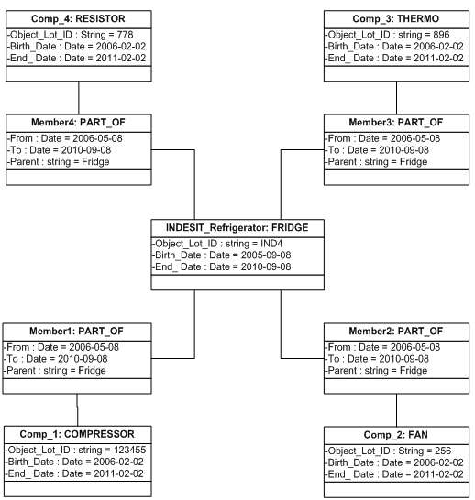
QLM Refrigerator Component Concepts

Slide 4
Mapping Resistor Component Concept to UDEF
Identify the applicable UDEF property word that characterizes the dominant attribute (property) of the data element concept. For above example = Identifier
Identify the dominant UDEF object word that the dominant property (selected in step 1) is describing. For above example = Product_Identifier
By reviewing the UDEF tree for the selected property identified in step 1, identify applicable qualifiers that are necessary to unambiguously describe the property word term. For above example = Lot Identifier
By reviewing the UDEF tree for the selected object identified in step 2, identify applicable qualifiers that are necessary to unambiguously describe the object word term. For above example = Resistor Component Part Product
Concatenate the object term and the property term to create a UDEF naming convention compliant name where it is recognized that the name may seem artificially long. For above example = Resistor Component Part Product_Lot Identifier
Derive a structured ID based on the UDEF taxonomy that carries the UDEF inherited indexing scheme. For above example <ResistorComponentPartProductLotIdentifier UDEFID=“a.f.g.9_34.8”>

Slide 5
QLM to UDEF Mappings
UDEF Object | UDEF Property | UDEF ID
Resistor Component Part Product | Lot Identifier | a.f.g.9_34.8
Resistor Component Part Product | Manufacture Date | a.f.g.9_15.6
Resistor Component Part Product | Usage End Date | a.f.g.9_2.56.6
Thermocouple Component Part Product | Lot Identifier | b.f.g.9_34.8
Thermocouple Component Part Product | Manufacture Date | b.f.g.9_15.6
Thermocouple Component Part Product | Usage End Date | b.f.g.9_2.56.6
Refrigerator Assembly Product | Serial Identifier | b.o.9_31.8
Refrigerator Assembly Product | Assembly Date | b.o.9_2.6
Refrigerator Assembly Product | Usage End Date | b.o.9_2.56.6
Compressor Component Part Product | Lot Identifier | c.f.g.9_34.8
Compressor Component Part Product | Manufacture Date | c.f.g.9_15.6
Compressor Component Part Product | Usage End Date | c.f.g.9_2.56.6
Fan Component Part Product | Lot Identifier | d.f.g.9_34.8
Fan Component Part Product | Manufacture Date | d.f.g.9_15.6
Fan Component Part Product | Usage End Date | d.f.g.9_2.56.6

Slide 6
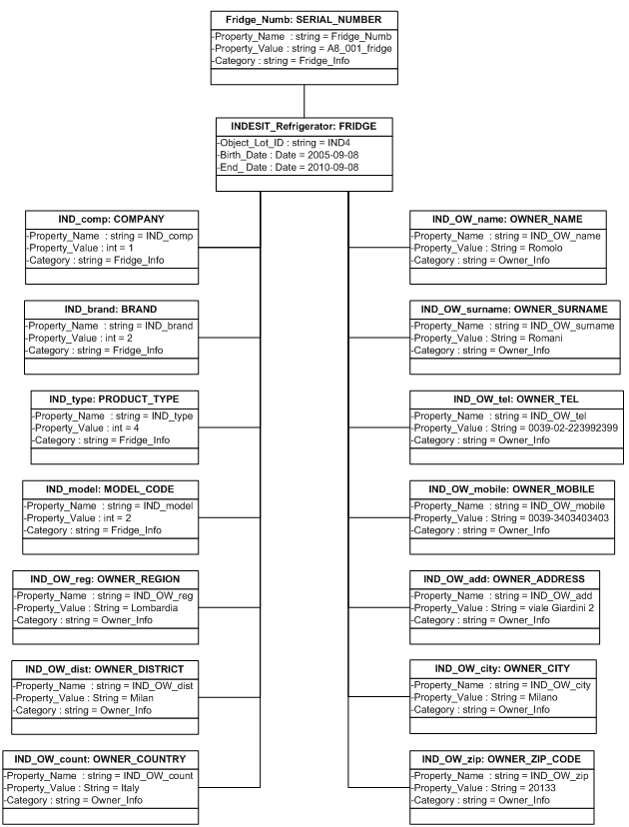
QLM Refrigerator ID and Owner Concepts

Slide 7
QLM to UDEF Mappings - continued

Slide 8
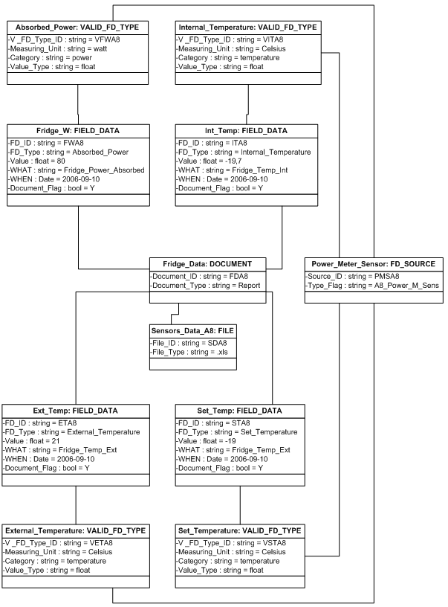
QLM Refrigerator Sensor Measurement Concepts

Slide 9
QLM to UDEF Mappings - continued

Slide 10
QLM to UDEF Mappings – XML Files – 2 Systems
Refrig1 System
Refrig2 System
<?xml version="1.0" encoding="UTF-8" ?>
<Refrig>
<Resistor>
<LotID GUID="a.f.g.9_34.8">1234</LotID>
<BirthDate GUID="a.f.g.9_15.6">2009-04-15</BirthDate>
<EndDate GUID="a.f.g.9_2.56.6">2019-04-15</EndDate>
</Resistor>
<Thermocouple>
<LotID GUID="b.f.g.9_34.8">XY12B</LotID>
<BirthDate GUID="b.f.g.9_15.6">2009-04-10</BirthDate>
<EndDate GUID="b.f.g.9_2.56.6">2012-04-10</EndDate>
</Thermocouple>
<Fan>
<LotID GUID="d.f.g.9_34.8">45A18</LotID>
<BirthDate GUID="d.f.g.9_15.6">2009-04-20</BirthDate>
<EndDate GUID="d.f.g.9_2.56.6">2014-04-20</EndDate>
</Fan>
</Refrig>
<?xml version="1.0" encoding="UTF-8" ?>
<Refrig>
<Resistor>
<LotNum GUID="a.f.g.9_34.8">1234</LotNum>
<MfgDate GUID="a.f.g.9_15.6">2009-04-15</MfgDate>
<ShelfDate GUID="a.f.g.9_2.56.6">2019-04-15</ShelfDate>
</Resistor>
<Thermocouple>
<LotNum GUID="b.f.g.9_34.8">XY12B</LotNum>
<MfgDate GUID="b.f.g.9_15.6">2009-04-10</MfgDate>
<ShelfDate GUID="b.f.g.9_2.56.6">2012-04-10</ShelfDate>
</Thermocouple>
<Fan>
<LotNum GUID="d.f.g.9_34.8">45A18</LotNum>
<MfgDate GUID="d.f.g.9_15.6">2009-04-20</MfgDate>
<ShelfDate GUID="d.f.g.9_2.56.6">2014-04-20</ShelfDate>
</Fan>
</Refrig>

Slide 11
QLM to UDEF Mappings – XML Files – 2 Languages
English System
Italian System
<?xml version="1.0" encoding="UTF-8" ?>
<Refrig>
<Resistor>
<LotID GUID="a.f.g.9_34.8">1234</LotID>
<BirthDate GUID="a.f.g.9_15.6">2009-04-15</BirthDate>
<EndDate GUID="a.f.g.9_2.56.6">2019-04-15</EndDate>
</Resistor>
<Thermocouple>
<LotID GUID="b.f.g.9_34.8">XY12B</LotID>
<BirthDate GUID="b.f.g.9_15.6">2009-04-10</BirthDate>
<EndDate GUID="b.f.g.9_2.56.6">2012-04-10</EndDate>
</Thermocouple>
<Fan>
<LotID GUID="d.f.g.9_34.8">45A18</LotID>
<BirthDate GUID="d.f.g.9_15.6">2009-04-20</BirthDate>
<EndDate GUID="d.f.g.9_2.56.6">2014-04-20</EndDate>
</Fan>
</Refrig>
<?xml version="1.0" encoding="UTF-8" ?>
<Frigo>
<Resistenza>
<Lotto GUID="a.f.g.9_34.8">1234</Lotto>
<Nato GUID="a.f.g.9_15.6">2009-04-15</Nato>
<Morto GUID="a.f.g.9_2.56.6">2019-04-15</Morto>
</Resistenza>
<Termocoppia>
<Lotto GUID="b.f.g.9_34.8">XY12B</Lotto>
<Nato GUID="b.f.g.9_15.6">2009-04-10</Nato>
<Morto GUID="b.f.g.9_2.56.6">2012-04-10</Morto>
</Termocoppia>
<Ventola>
<Lotto GUID="d.f.g.9_34.8">45A18</Lotto>
<Nato GUID="d.f.g.9_15.6">2009-04-20</Nato>
<Morto GUID="d.f.g.9_2.56.6">2014-04-20</Morto>
</Ventola>
</Frigo>

Slide 12
QLM to UDEF Mappings – XML Files – 2 Languages
English System
Finnish System
<?xml version="1.0" encoding="UTF-8" ?>
<Refrig>
<Resistor>
<LotID GUID="a.f.g.9_34.8">1234</LotID>
<BirthDate GUID="a.f.g.9_15.6">2009-04-15</BirthDate>
<EndDate GUID="a.f.g.9_2.56.6">2019-04-15</EndDate>
</Resistor>
<Thermocouple>
<LotID GUID="b.f.g.9_34.8">XY12B</LotID>
<BirthDate GUID="b.f.g.9_15.6">2009-04-10</BirthDate>
<EndDate GUID="b.f.g.9_2.56.6">2012-04-10</EndDate>
</Thermocouple>
<Fan>
<LotID GUID="d.f.g.9_34.8">45A18</LotID>
<BirthDate GUID="d.f.g.9_15.6">2009-04-20</BirthDate>
<EndDate GUID="d.f.g.9_2.56.6">2014-04-20</EndDate>
</Fan>
</Refrig>
<?xml version="1.0" encoding="UTF-8" ?>
<Jääkaappi>
<Vastus>
<SarjaNumero GUID="a.f.g.9_34.8">1234</SarjaNumero>
<SyntymäPvm GUID="a.f.g.9_15.6">2009-04-15</SyntymäPvm>
<LoppuPvm GUID="a.f.g.9_2.56.6">2019-04-15</LoppuPvm>
</Vastus>
<Termopari>
<SarjaNumero GUID="b.f.g.9_34.8">XY12B</SarjaNumero>
<SyntymäPvm GUID="b.f.g.9_15.6">2009-04-10</SyntymäPvm>
<LoppuPvm GUID="b.f.g.9_2.56.6">2012-04-10</LoppuPvm>
</Termopari>
<Tuuletin>
<SarjaNumero GUID="d.f.g.9_34.8">45A18</SarjaNumero>
<SyntymäPvm GUID="d.f.g.9_15.6">2009-04-20</SyntymäPvm>
<LoppuPvm GUID="d.f.g.9_2.56.6">2014-04-20</LoppuPvm>
</Tuuletin>
</Jääkaappi>

Slide 13
Gap Analysis Tools Demo

Slide 14
Example Open Group Gap Analysis Reports
https://jserver.opengroup.org/UDEF/UdefReport1
Systems Comparison
Languages Comparison
UDEF GUID | Refrig1.txt | Refrig2.txt
a.f.g.9_15.6 | {}BirthDate | {}MfgDate
a.f.g.9_2.56.6 | {}EndDate | {}ShelfDate
a.f.g.9_34.8 | {}LotID | {}LotNum
b.f.g.9_15.6 | {}BirthDate | {}MfgDate
b.f.g.9_2.56.6 | {}EndDate | {}ShelfDate
b.f.g.9_34.8 | {}LotID | {}LotNum
d.f.g.9_15.6 | {}BirthDate | {}MfgDate
d.f.g.9_2.56.6 | {}EndDate | {}ShelfDate
d.f.g.9_34.8 | {}LotID | {}LotNum
UDEF GUID | Refrig1-IT.txt | Refrig1-FI.txt
a.f.g.9_15.6 | {}Nato | {}SyntymäPvm
a.f.g.9_2.56.6 | {}Morto | {}LoppuPvm
a.f.g.9_34.8 | {}Lotto | {}SarjaNumero
b.f.g.9_15.6 | {}Nato | {}SyntymäPvm
b.f.g.9_2.56.6 | {}Morto | {}LoppuPvm
b.f.g.9_34.8 | {}Lotto | {}SarjaNumero
d.f.g.9_15.6 | {}Nato | {}SyntymäPvm
d.f.g.9_2.56.6 | {}Morto | {}LoppuPvm
d.f.g.9_34.8 | {}Lotto | {}SarjaNumero

Slide 15
Example Enhanced Gap Analysis Reports
http://www.udef-it.com/
Systems Comparison
Languages Comparison

Slide 16
Contact Information

